Slide 1
Schwannoma nervi vestibulocochlearis Patogenesis
It grows from Schwann cells of upper vestibular nerv – schwannoma
It grows in the internal auditory meatus towards pontocerebelar cistern
Staging according to size
Small intrameatal (up to 1cm)
Midsize (up to 2,5cm)
Big (2,5-4cm)
Giant

Slide 2
Schwannoma nervi vestibulocochlearis Symptomatology
Hearing loss
Any sensorineural hearing los may be the sign of schwannoma n.VIII
Tinnitus
Majority of patients suffer from tinnitus
Vestibular symptomatology
There use to be a period of vestibular symptomatology patient may forget because of adaptation
Faciel nerve dysfunction
Very rare in the diagnostic period
Symptomatology from the brain stem oppression
Terminal stage in giant tumors

Slide 3
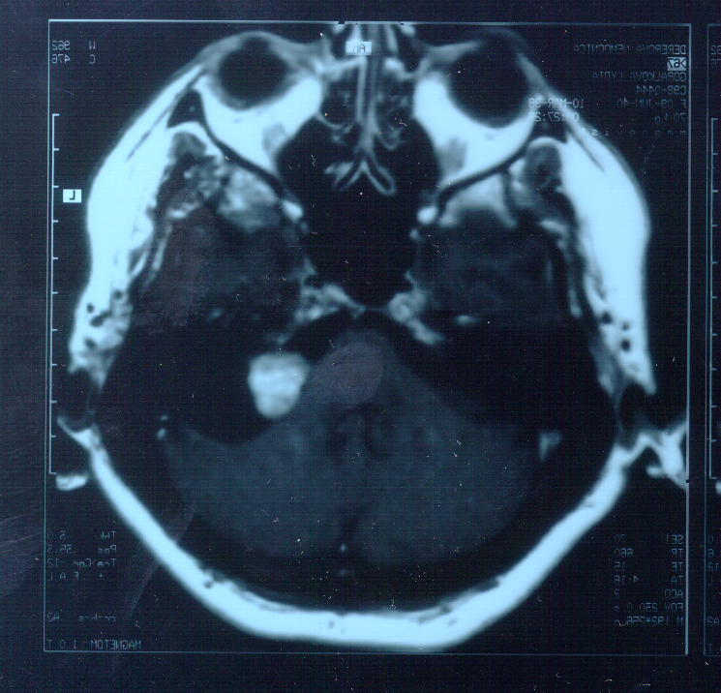
Schwannoma nervi vestibulocochlearis Diagnosis
Imageing
CT
MRI – decisive
Audiology tests
Vestibular tests
Deterioration or lost of vestibular function
Neurologic tests
Oftalmologic tests

Slide 4
Schwannoma nervi vestibulocochlearis Audiology
Retrocochlear hearing loss is typical, but any may develop
Audiologic tests have only a complementary role, MRI is decisive
Tone audiometry (PTA)
Speech audiometry
Stapedial reflex threshold
Positive decay test
BERA

Slide 5
Schwannoma nervi vestibulocochlearis Diagnostic principles
Any patient with unilateral SNHL and/or tinnitus must have MRI

Slide 6
Schwannoma nervi vestibulocochlearis Treatment
Surgery
Translabyrinthine
Retrosigmoid
Middle fossa
Non surgical
Irradiation (Gama knife, fractionised RT)
Wait and scan

