Slide 1
Implantable hearing devices: Where we are
Milan Profant
Lukáš Varga, Zuzana Kabátová
Univ. Dept. of ORL HNS, Bratislava Slovakia

Slide 2
Implantable hearing devices
Topics
History of Implantable hearing devices
Types of Implantable hearing devices
Indications for Implantable hearing devices
Surgery
Our experience
Future of Implantable hearing devices
Discussion

Slide 3
Implantable hearing devices
History of Bone Conduction Implants (BCI)
Bone conduction devices
  Already during the renessaince period Girolamo Cardano demonstrated amplification of sound when transmitted through the spear hold by the teeth
  Original BC device: Anders Tjellström in 1977 – BAHA

Slide 4
Implantable hearing devices
History of AME
Alvar Wilska (1911–1987), Finnish scientist in 1935 placed pieces of iron on the ear drum and with electromagnetic coil created magnetic field and vibrations
Rutschmann in 1959 attached 10mg magnet to the ear drum and created alternating EM field with vibrations
Goode (1970), Fredrickson (1973) a Nunelly (1976) already placed the source of energy to the ear drum

Slide 5
Audiologic indications for BCI
In majority of BCI the BC threshold should not exceed 40dB
Output of transcutaneous BCI is in average 15dB less the percutaneous

Slide 6
Types of implants
BAHA (Cochlear)
BAHA Attract (Cochlear)
BONEBRIDGE (Medel)
SOUNDBRIDGE (Medel)
SOPHONO (Medtronic)
ADHEAR (Medel)

Slide 7
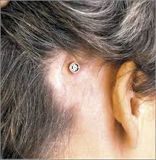
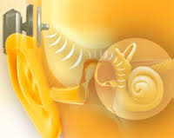
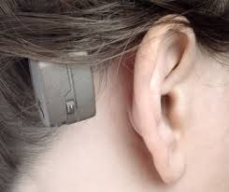
BAHA Connect and BAHA Attract
Percutaneous vs. Transcutaneous

Slide 8
BAHA Candidacy
Conductive Hearing Loss
  The conductive component of the hearing loss is greater than 30 dB
Mixed Heearing Loss
  BC threshold up to 50/60dB
    BAHA 5 (45)
    BAHA 5 Power (55)
    BAHA 5 Superpower (65)
Single sided deafness
  BC threshold in the hearing ear up to 20dB

Slide 9
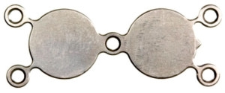
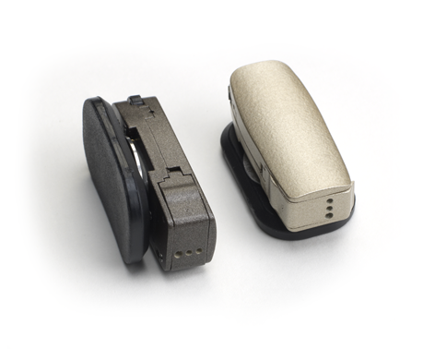
SOPHONO
BC threshold
30-40dB
(20dB)

Slide 10
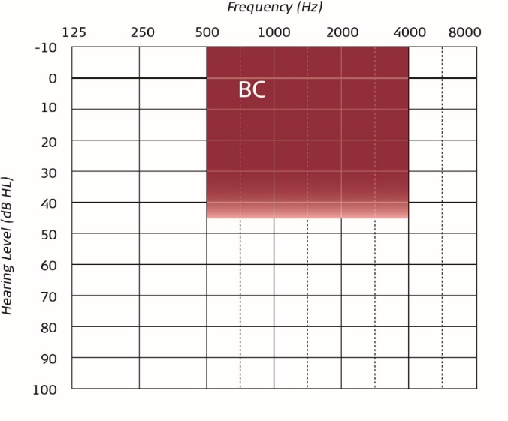
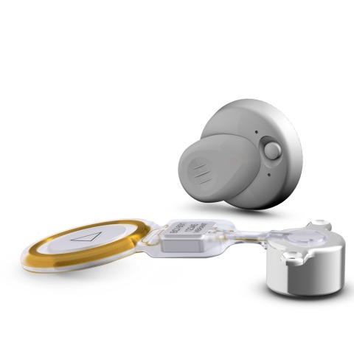
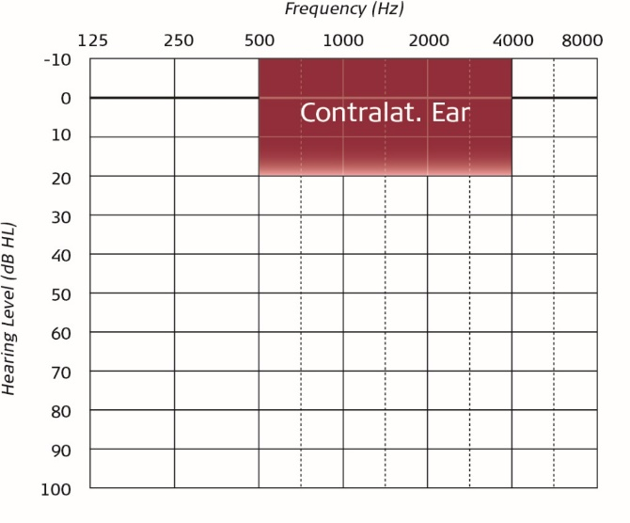
BONEBRIDGE
BC threshold
40-45dB
(30dB)

Slide 11
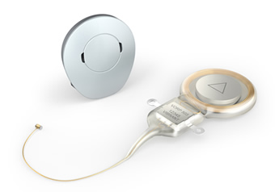
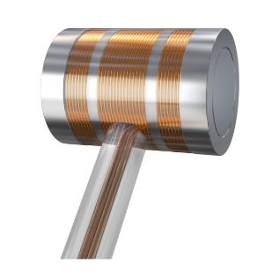
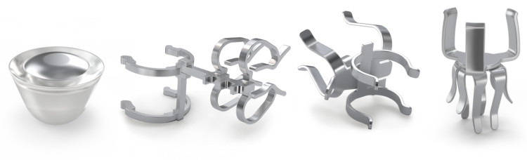
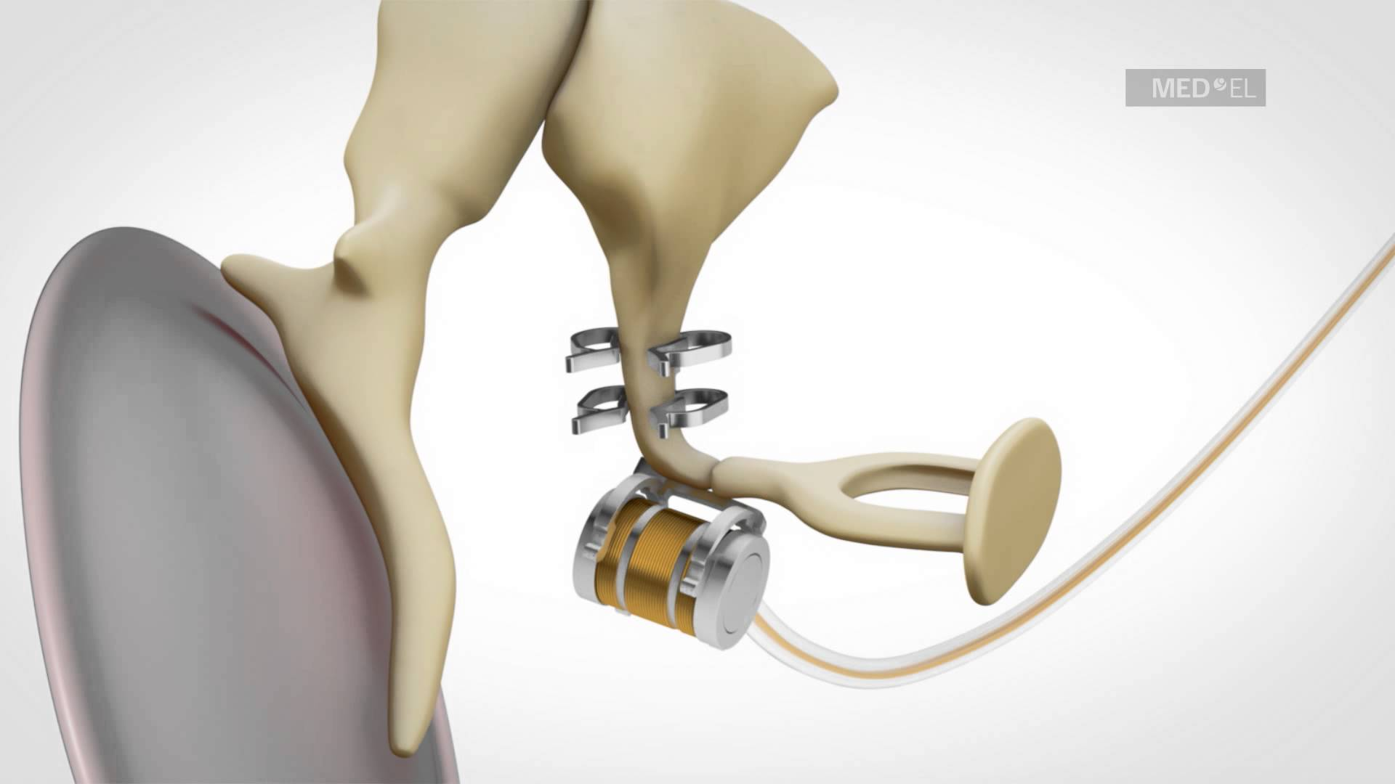
SOUNDBRIDGE
Round window
Incus short process
Incus long process
Stapes
Piston
BC threshold 50dB (RW aplication)

Slide 12
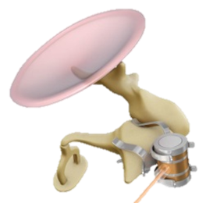
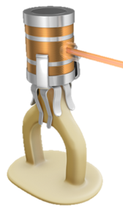
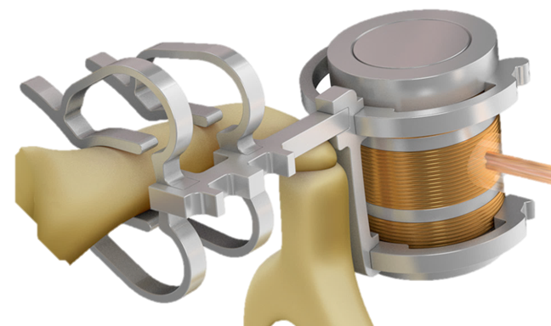
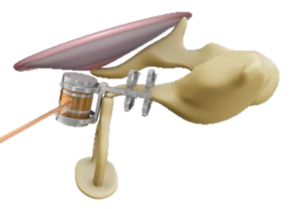
VibrantSoundbridge with Couplers
Incus – short process
Stapes head
Incus – long process

Slide 13
Implantable hearing devices
Mixed hearing loss: When to implant
Primary surgery
  External and middle ear atresia uni- and bilateral
Revision surgery
  Second revision in unfavorable anatomical and functional condition
  Need of the 3rd revision is indication for appropriate implant
Salvage surgery
  Unilateral deafness after schwannoma removal

Slide 14
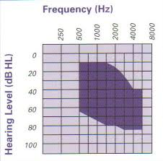
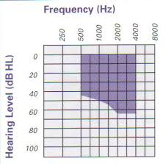
Audiological indications
SNHL
Mixed HL

Slide 15
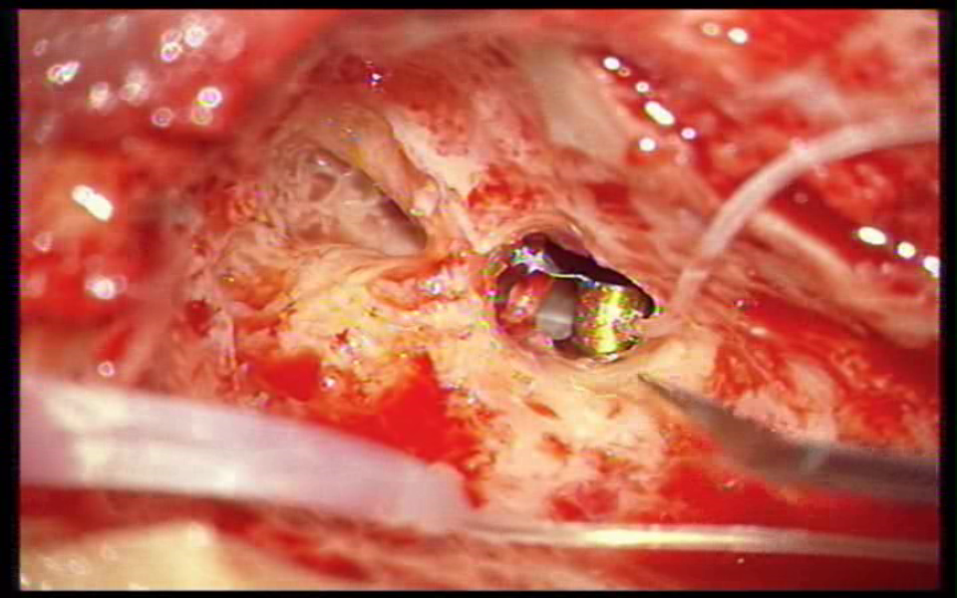
VSB pri SNHL

