Slide 1
Deafness rehabilitation Types of deafness
For the clinical development of human beeing we categorize types of deafness according to the onset of deafness in relation to the speech development
Prelingual deafness – before the speech development
0-2 y
Perilingual deafness – during the speech development
2-6y
Postlingual deafness– after the speech development and its fixation
6+y

Slide 2
Deafness rehabilitation cochlear implantation
Acquired deafness
Average hearing threshold 90+dB
With hearing aid 60+ dB
Words discrimination with HA up to 50%
Congenital deafness
Newborn hearing screening OAE, BERA
Behavioral follow up of speech development

Slide 3
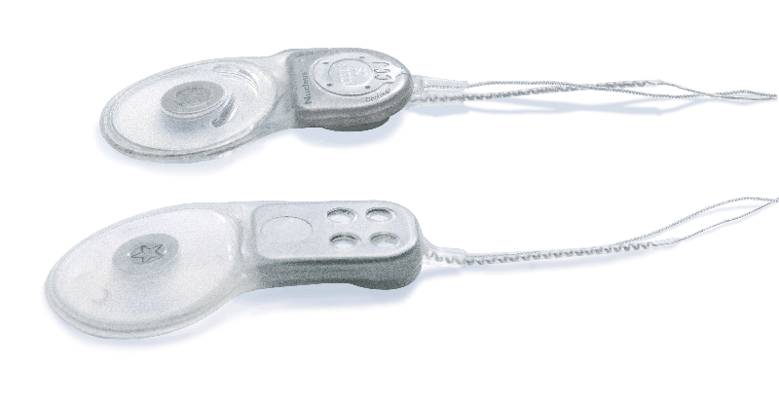
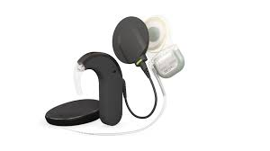
Deafness rehabilitation Acquired deafness (postlingual)
Speech is not affected
It may loose its melodic quality but the vocabulary remains intact
With CI patient may get very good communication skills (patients can telephone)

Slide 4
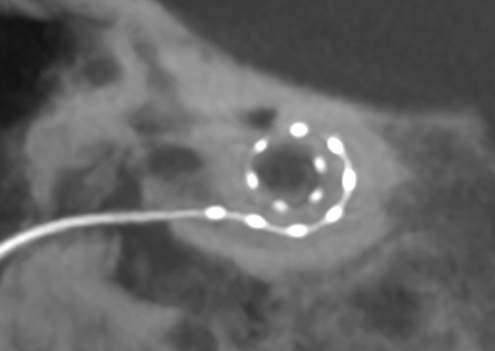
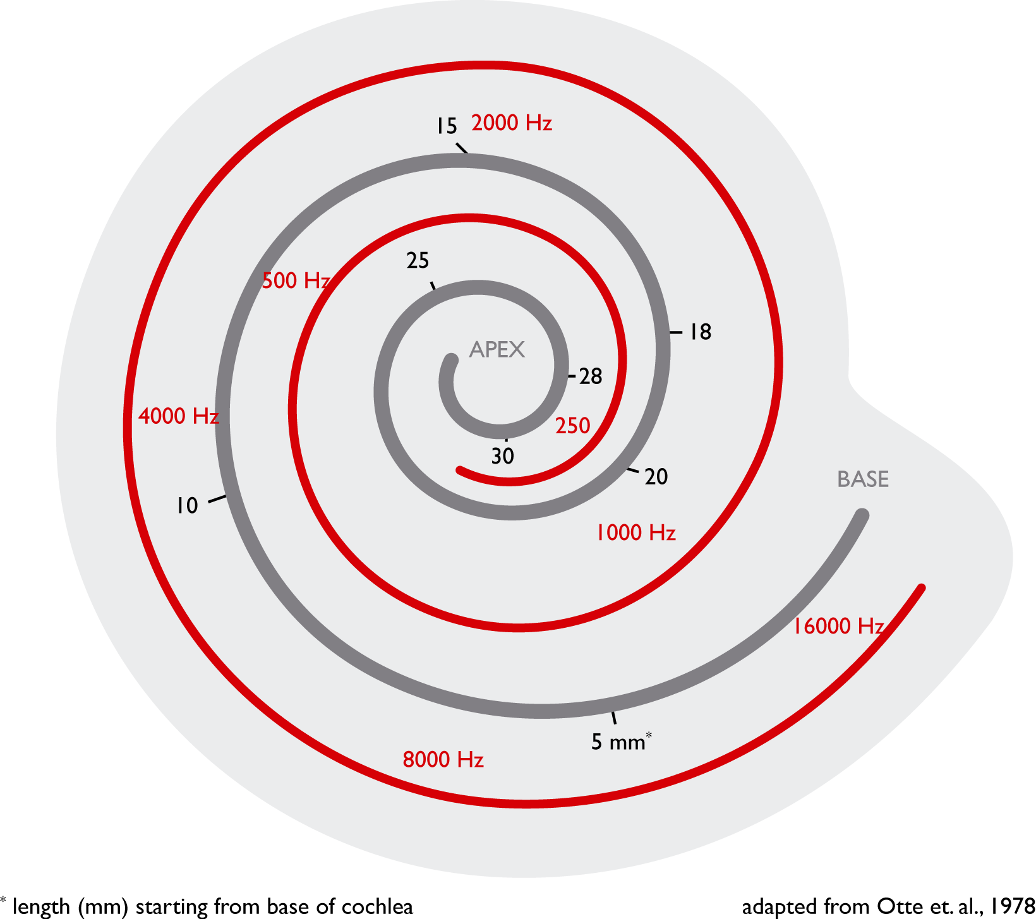
Cochlear implant
Internal part (demodulator, electrods):
Tonotopic position (up to the cochlear apex)
External part
Microphone
Procesor – to process sounds caught by mic and transform them to electric signal
Coil with magnet – tanscutaneous transfer to the internal part

Slide 5
Principle of cochlear implantation elektric stimulation of functional acoustic nerve by electrode array inserted into the cochlea

Slide 6
Deafness rehabilitation Candidate selection for CI
Age and type of deafness
Audiologic criteria
Speech therapeut criteria (cooperation in rehab)
Psychologic criteria (motivation, quality of family environment)
Medical criteria

Slide 7
Surgery
Demodulator and magnet
External coil
Cochlea with inserted electrode
Procesor

Slide 8
Deafness rehabilitation Surgery
Skin incision
Mastoidectomy, implant bed
Opening of recessus facialis
Opening of cochlea – scala tympani
Electrode insertion
Suture

Slide 9
Results in postlingually deaf patients Tone audiometry

Slide 10
Results in postlingually deaf patients Speech audiometry

Slide 11
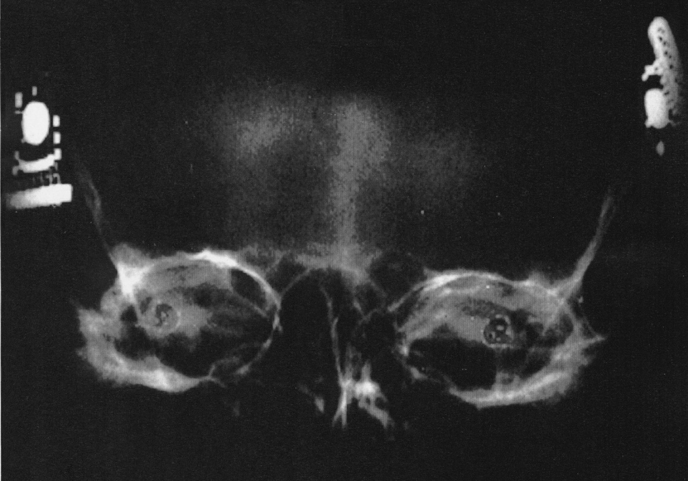
Bilateralna cochlear implantation
Directional hearing
Better understanding in noisy environment
Elektródy v kochlei

Slide 12
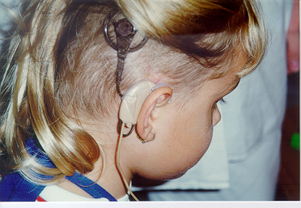
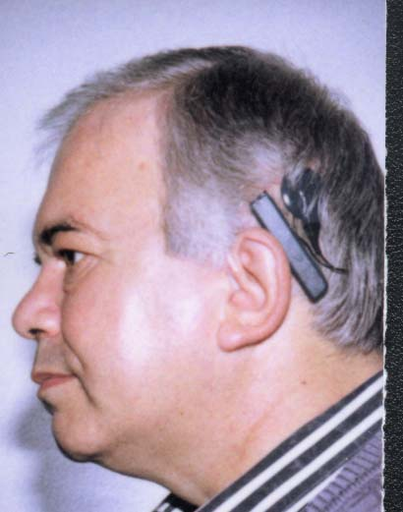
Deafness rehabilitation rehab
Prelingual deaf children
Intensive rehab as with deaf child
Sound perception
Sound identification
Identification of words and sentences
Speech production
Postlingual deaf
Adaptation on hearing with CI
Everyday sounds, words, sentences

Slide 13
Deafness rehabilitation Cochlear implantation – results
Postlingval deaf
They come back to communication based on hearing input
They can telephone
Prelingval deaf
Implanted at age 1-5
Normal speech development, attending mainstream schools
Implanted at age 5-10
Ability to perceive sounds, lipreading improvement
Implanted at later age
Iformation on environment sounds

